Slide 1
New Points Based Immigration System - Briefing
HR Clinics
Notes:
Welcome
Thank you for your time. Hour and a half set aside. Time to ask questions at the end or add a question to the chat.
Will cover:
EU SS
New PBS
Right to work checks
What this means for BU and recruiting managers
Other routes of entry

Slide 2
Introduction
The points-based immigration system will work for the whole of the UK and will apply to all nationalities other than British or Irish citizens from January 2021 (post-Brexit and the end of free movement).
Change
EEA nationals are treated exactly the same as non-EEA nationals
Timeline
The new PBS opened on 1 December 2020 (replacing the Tiered system) and all non-UK nationals can now apply under this system.
Notes:
Give an overview of the new points based system – which will replace the Tiered system we currently use. Tiers 1 – 5.
Partic focus for us are 2 routes:
Skilled Worker route which will replace Tier 2 and the Temporary Worker route which will replace Tier 5.

Slide 3
EU Settlement Scheme
All EU citizens resident in the UK before 11pm on 31 December 2020, will be eligible to apply for the EU Settlement Scheme, which will allow EU citizens to continue living and working in the UK.
Therefore any EU citizen resident in the UK before 11pm on 31 December 2020, will not be subject to the new Points Based Immigration System.
Applications for the EU Settlement Scheme can be made until 30 June 2021.
An applicant will usually be granted ‘settled’ status if they’ve:
started living in the UK by 31 December 2020
lived in the UK for a continuous 5-year period (known as ‘continuous residence’)
If an applicant does not have 5 years’ continuous residence when
they apply, they’ll usually receive ‘pre-settled’ status. They can then
stay in the UK for a further 5 years to be granted settled status.
Notes:
EUSS was introduced opened on 30 March 2019
Pre-settled status – can not leave the UK for more than 6 months, as don’t meet the ‘continuous residence’ requirements and therefore cannot apply for settled status.

Slide 4
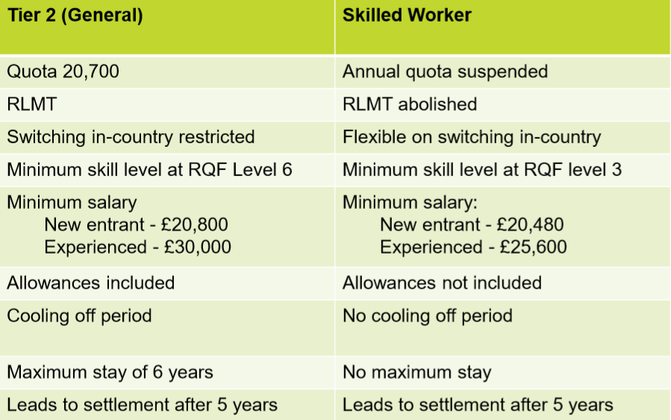
Tier 2 General vs Skilled Worker
Notes:
‘Going rate’ = salary tied to occupation

Slide 5
Skilled Worker Route
The Skilled Worker Route (SWR) replaces the current Tier 2 (General) route.
The key elements of the SWR are:
A job offer from a UK licensed sponsor required
Suspension of the annual cap on entrants to the UK
No resident labour market test
Due to these changes, there are potential time savings for BU in relation to our current recruitment timelines and the Government have highlighted their intention to further reduce timescales through additional enhancements to the system beyond January.

Slide 6
Eligibility for a Skilled Worker Visa
Under the new Points Based System, points are assigned for specific skills, qualifications, salaries and shortage occupations; and visas are awarded to those who gain sufficient points. All applicants coming to work under the SWR will require 70 points.
This will comprise of 50 Mandatory points and 20 Tradeable points.
50 Mandatory points:
20 points - Job offer from an approved sponsor (e.g. BU)
20 points - Job at appropriate Skill level (RQ3 compared to RQ6 for Tier 2)
10 points - English language – B1 CEFR (the same level as is
currently required under Tier 2)

Slide 7
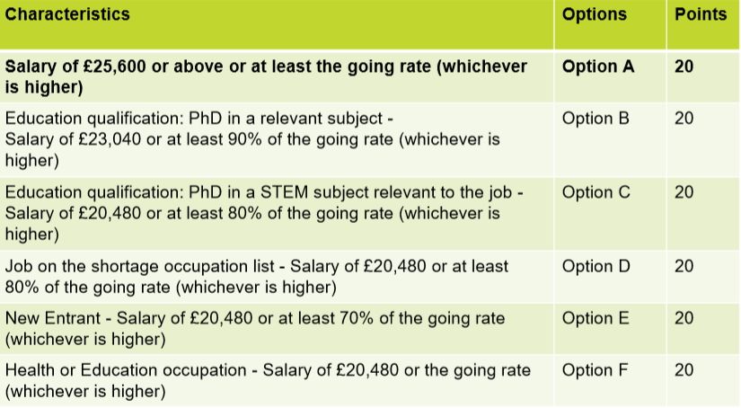
20 Tradeable points: These can be obtained through the following combinations:
Notes:
Option F – Education –Schools and FE not HEIs,

Slide 8
Salary Considerations:
The general salary threshold will be lowered from £30,000 to £25,600 a year and sponsors must pay their skilled workers a salary which equals or exceeds both this threshold and the ‘going rate’ for the occupation (whichever is higher).
Every role eligible for sponsorship at BU will have an associated SOC, with each SOC having a ‘going rate’ – which reflects the salary that each sponsored role should be paid.
Under the new system the salary thresholds and going rates for the majority of our sponsored roles (Lecturer/Post Doc Researcher) is higher than was the case under Tier 2.
As under Tier 2, going rates for individual occupations can be pro-rated depending on the applicant’s working pattern, as
long as the total applicable general salary threshold is met.

Slide 9
Options A, B, C: Salary Considerations
Option A – salary of £25,600 or above or at least the ‘100% of the ‘going rate’ for their SOC (whichever is higher) = 20 points (and with the mandatory 50 points, will make the migrant eligible for sponsorship)
Option B – salary of £23,040 or at least 90% of the ‘going rate’ (whichever is higher), plus PhD in relevant subject = 20 points
Option C – salary of £20,480 or at least 80% of the ‘going rate’ (whichever is higher), plus PhD in a STEM subject = 20 points
As can be seen, tradeable points (options B and C) are often linked
to an individual’s qualifications, and therefore eligibility for
sponsorship can no longer be established on the role alone.

Slide 10
Option B and C: PhD’s
Applicants can only score points for having a PhD relevant to the job and BU must be able to justify where this is used, and also whether it can be considered a STEM PhD. Please note that the individual applicant must hold a PhD rather than the role itself being classed as ‘PhD level’, as was the case under the Tier 2 system.
Applicants will also only be able to score points for having a PhD when working in certain occupations. A list of occupations able to claim PhD points will be kept under review but for the initial launch of the route, the list will include the SOC codes used by BU for the majority of our sponsored roles (e.g. Lecturer and Post-Doc Researcher). This list also includes a small number of additional STEM jobs, such as lab technicians, which do
not appear in the top skill level but which involve research.

Slide 11
Option E - New Entrant
Option E – salary of £20,480 or at least 70% of the ‘going rate’ (whichever is higher) = 20 points
To be classed as a ‘New Entrant’, the applicant must meet one of the following criteria:
Under 26 years old
Postdoctoral positions – scientists or higher education professionals
Most recent leave as a Student (expired less than 2 years before date of application) and sponsored to study (Bachelors, Masters, or PhD)
Has completed or within 3 months of completion of a course, or completed 12 months of a PhD
The applicant can only qualify as a new entrant for a maximum period of 4 years in total* (whether or not the 4 year period is continuous).
*Time spent in the Graduate route will count towards the total
length of time an applicant can be classed as a new entrant.

Slide 12
Example: Lecturer
LECTURER (2311)
Based on the ‘going rate’ for SOC code 2311 (£40,700), the migrant would need to be appointed above the minimum spine point (31) – on point 35, to score 20 points based on their salary alone.
Trading points and reducing the salary to 90% of the ‘going rate’ will allow a migrant to be appointed at the minimum spine point (31) and receive 10 points. However they would also require a relevant PhD (10 points) to accumulate the required 20 tradeable points
No issue with a New Entrant, as they can score 20 points by being appointed on the minimum spine point (31).
In addition SOC code 2311 will allow all new
Skilled Worker applicants to be classed as New Entrants.

Slide 13
Example: Post Doctoral Researcher
Post Doctoral Researcher (2119)
Based on the ‘going rate’ for SOC code 2119 (£33,000), The migrant would need to be appointed above the minimum spine point (26) – on point 28, to score 20 points based on their salary alone.
Trading points and reducing salary to 90% of the ‘Going Rate’ will allow a migrant to be appointed at the minimum spine point (26) and receive 10 points. However they would also require a relevant PhD (10 points) to accumulate the required 70 points.
No issue with a New Entrant, as they can score 20 points being appointed on the minimum spine point (26).
In addition SOC code 2119 will allow all new
Skilled Worker applicants to be classed as New Entrants.

Slide 14
Right to Work checks
Right to Work checks between 1 January 2021 and 30 June 2021:
Employers are currently advised to complete right to work checks in the same way as they are now, e.g. a Passport or EU National Identity card can still be used as evidence of an EU citizen’s right to work, without needing to confirm whether they have applied for the EU Settlement Scheme.
The Home Office have confirmed that there is nothing to stop employers enquiring if an individual has settled or pre-settled status, however applicants are not obligated to provide this information or share evidence.
It is important that asking this question does not lead to any discriminatory action (e.g. it should not determine a recruitment
decision).

Slide 15
Right to Work checks
If BU are made aware that an EU citizen is not eligible to apply for the EU Settlement Scheme and does require a visa, then we would no longer be able to rely on a Passport or EU National Identity card to provide a statutory excuse against a potential illegal working fine.
EU citizens granted a Skilled Worker visa will be provided with an e-visa, rather than a Biometric Residence Permit. In order to complete a Right to Work check, they will be able to provide a ‘Share Code’ to enable HR to complete a Government online Right to Work check.
EU citizens can also evidence their status under the EU Settlement Scheme to HR using the same online Right to Work check.
Non-EU citizens granted a Skilled Worker visa will continue to be issued a Biometric Residence Permit and as such their visa can be
verified both in person OR online by the HR Services team.

Slide 16
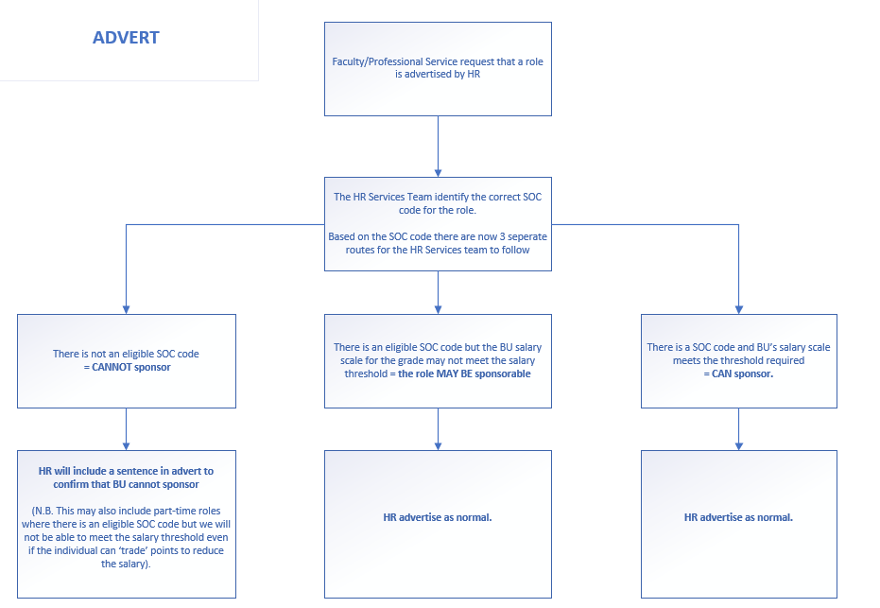
Amended Recruitment Process

Slide 17
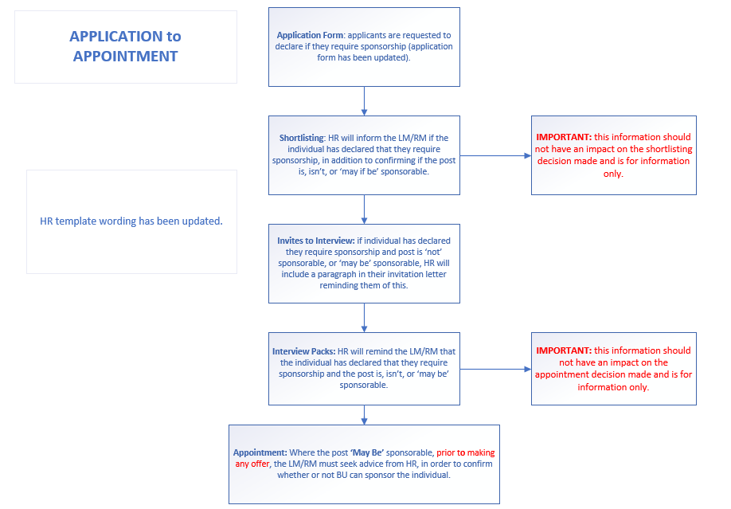
HR Services: Recruitment Process

Slide 18
Discrimination Considerations:
It is extremely important to ensure that recruitment decisions are not based on an applicant’s nationality and their assumed or known right to work in the UK.
Offers should be made to the best candidate for the role, however if your preferred candidate requires sponsorship and the role is ‘not’ sponsorable or ‘may be’ sponsorable, no offer should be made without prior discussion with HR.
In certain cases, the LM/RM may need to sensitively liaise with the preferred candidate in order to obtain further information or to discuss right to work options (e.g. the applicant may be eligible to apply for a visa under another immigration category).
Any policy or recruitment practice which disproportionately impacts EEA, Swiss citizens and non-EU nationals is likely to expose employers
to indirect race discrimination claims.

Slide 19
Example: Cannot Sponsor
HR receive a request to advertise a Full Time Global Engagement Coordinator role and a Part Time (0.5 FTE = £12,970) Demonstrator role
Upon review by HR, the Global Engagement Officer role does not have an eligible SOC code and is therefore ineligible for sponsorship.
The Demonstrator role does have an eligible SOC code (3563), however the ‘Going Rate’ is £23,400, with an absolute minimum salary of £20,480 (including for New Entrants), therefore even if appointing at the top of Grade 5 (which would lead to issues of equity), this role would still not be eligible for sponsorship at 0.5 FTE (due to salary requirements)
These roles are advertised with wording included to advise that they are not eligible for sponsorship.
At shortlisting stage, two applicants advise that they require sponsorship, the LM/RM are informed and advised that the post is ineligible for sponsorship, but this should not impact their recruitment decision.

Slide 20
Example: Cannot Sponsor
In their ‘invite to interview’, the two applicants who advised that they require sponsorship, receive an additional paragraph, confirming that these posts are not eligible for sponsorship.
The LM/RM would like to make an offer to the two individuals who require sponsorship (they inform HR before making any offer).
HR advise the LM/RM that conversations should now take place with these individuals to determine if they may be eligible to work in the UK under another immigration category.
HR will advise that these discussions should support the individuals, ensuring that no discriminatory action is taken, whilst also being clear that the Skilled Worker route is not an option, either due to the lack of an
eligible SOC code (Global Engagement Coordinator role) or the inability
to meet the appropriate salary threshold (Demonstrator role).

Slide 21
Example: ‘May Be’ able to sponsor
HR receive a request to advertise a Service Desk Support Analyst role (Grade 4 - £21,814), x2 positions.
Upon review by HR, this role has an eligible SOC code (3132), but due to the associated salary requirements, the role can only be classed as ‘May Be’ eligible for sponsorship (‘going rate’ of £24,400, therefore the higher general salary threshold of £25,600 applies).
HR advertise the role as normal.
At the shortlisting stage, two applicants advise that they require sponsorship, the LM/RM are informed and advised that the role ‘May Be’ sponsorable, and that this information should not impact any recruitment decision.
In their ‘invite to interview’, the applicants who advised that they
require sponsorship, receive an additional paragraph, confirming
that the post ‘May Be’ eligible for sponsorship.

Slide 22
Example: ‘May Be’ able to sponsor
The LM/RM would like to make an offer to the two individuals who require sponsorship. They inform HR before making any offer and advise the potential salaries to be offered (both offers being one point above the minimum spine point, at point 16, £22,417).
HR review the relevant ‘Application forms’ in an attempt to determine if the individuals are eligible for sponsorship, e.g. do they have a PhD (this will be relevant for certain SOC codes, however not this role), or in this case, can the individuals be classed as a ‘New Entrant’? If further information is required, the LM/RM are to liaise with the individuals based on guidance/wording from HR.
In this case, one individual is 25 years old and can be classed as a ‘New Entrant’. As they will be offered £22,417, this is above £20,480
or 70% of ‘Going Rate’ (whichever is higher).

Slide 23
Example: ‘May Be’ able to sponsor
This individual would therefore be eligible to be sponsored under the Skilled Worker route in this role (utilising Option E)
IMPORTANT: Consideration needs to be made regarding the fact that within 4 years* (the maximum duration of time a migrant can remain a ‘New Entrant’), the applicant would need to meet 100% of the ‘Going Rate’. In this case, factoring in potential cost of living and increment increases, the applicant is likely to meet 100% of the ‘Going Rate’ within this time period.
However if this was not the case, HR will have discussions with the LM/RM regarding the potential need to terminate the migrant’s employment after 4 years*, if they were unable to meet the appropriate salary threshold at that point.
*Time spent in the Graduate route will count towards the total
length of time an applicant can be classed as a new entrant.

Slide 24
Example: ‘May Be’ able to sponsor
For the applicant who can be classed as a ‘New Entrant’, they can be offered the role at point 16, and will receive offer paperwork confirming that that they require and can be offered sponsorship.
The other applicant is 28 years old and is unable to be classed as a ‘New Entrant’ under the New Entrant criteria (e.g. they are not a recent student). Therefore they would need to be paid £25,600 in order to be eligible for sponsorship. In this case, they were to be offered £22,417 (point 16).
The LM/RM is unable to justify a 5 point increase in the salary offered to the individual, to point 21 (£25,941), and to do so would cause issues equity in relation to pay within the team. Therefore this individual would be unable to be sponsored under the Skilled Worker route for this role.

Slide 25
Example: ‘May Be’ able to sponsor
HR will confirm to the LM/RM that this individual would not be eligible for sponsorship under the Skilled Worker route, and that conversations should now take place with the individual to determine if they may be eligible to work in the UK under another immigration category.
HR advise that this discussion should support the individual, ensuring that no discriminatory action is taken, whilst also being clear that the Skilled Worker route is not an option, due to the inability to meet the appropriate salary threshold for the role.
This example highlights how dependent upon the applicant, and the
salary offered, a role may or may not be eligible for sponsorship.

Slide 26
Example: ‘Can’ sponsor
HR receive a request to advertise a Full Time Tutor Mentor role (Grade 5).
Upon review by HR, the Tutor Mentor role has an eligible SOC code (2319) with a ‘Going Rate’ of £21,300 (therefore the general salary threshold of £25,600 applies).
If offering at the minimum spine point of Grade 5, at point 21, £25,941, the salary threshold will be met, therefore this role would be eligible for sponsorship under the Skilled Worker route, regardless of the applicant.
HR advertise the role as normal.
At the shortlisting and interview pack stage, HR inform the LM/RM that the role can be sponsored, and highlight applicants who will require this.
If the successful applicant requires sponsorship, HR will issue
offer paperwork confirming that they require and can be offered
sponsorship.

Slide 27
Next Steps: Post Offer
HR will issue a Certificate of Sponsorship under the Skilled Worker route and support the individual with their visa application (BU will reimburse the standard cost of a Skilled Worker visa £704/£610, however all other fees must be met by the individual).
As part of their visa application, the individual will need to provide:
proof of their knowledge of English
a bank/building society statement or letter that shows they have enough personal savings (£1,270 in a bank account in their name for at least 28 days). BU can certify maintenance on their behalf by exception.
a current passport or travel document to prove they can travel – with a blank page in their passport for their visa
expired passports or travel documents to show travel history (if requested)
a tuberculosis test results if they’re from a listed country
a criminal record certificate (if working with vulnerable people)

Slide 28
Next Steps: Post Offer
If applying for Skilled Worker visa from outside the UK, a decision on the visa should be made within 3 weeks (subject to attending an appointment at a UK Visa Application Centre to provide biometric information).
If applying for a Skilled Worker visa from within the UK, a decision on the visa can take between 8 and 12 weeks, dependent upon the complexity of their application and the volume of applications received.
To receive a faster decision on a visa application the Priority and Super Priority services may be available (subject to additional fees).
A start date cannot be confirmed, and an individual cannot commence work, until a Skilled Worker visa has been verified by a member of the HR Services Team.

Slide 29
Other Immigration Routes
Global Talent Scheme
The global talent scheme will be opened up to EU, EEA and Swiss citizens. It allows highly-skilled scientists and researchers to come to the UK without a job offer. To be considered for entry under the Global Talent visa, applicants must gain an endorsement from one of six endorsing bodies engaged by the Home Office (e.g. Tech Nation, UK Research and Innovation).
International Students – Graduate Route
The Graduate route will be launched in summer 2021 to provide international students with the opportunity to stay in the UK to work or look for work after they graduate. Undergraduate and Master's degree students will be able to live and work in the UK for two years under the route, whilst PhD students will be able to stay for three years.

Slide 30
Other Immigration Routes
Global Talent Scheme
The global talent scheme will be opened up to EU, EEA and Swiss citizens. It allows highly-skilled scientists and researchers to come to the UK without a job offer. To be considered for entry under the Global Talent visa, applicants must gain an endorsement from one of six endorsing bodies engaged by the Home Office (e.g. Tech Nation, UK Research and Innovation).
International Students – Graduate Route
The Graduate route will be launched in summer 2021 to provide international students with the opportunity to stay in the UK to work or look for work after they graduate. Undergraduate and Master's degree students will be able to live and work in the UK for two years under the route, whilst PhD students will be able to stay for three years.

Slide 31
Other Immigration Routes
Temporary Worker - Government Authorised Exchange visa (formerly Tier 5)
BU will continue to be able to sponsor Temporary Worker researchers.
Temporary Worker researchers are able stay in the UK for up to 24 months.
HR will be able to assess if an applicant meets the Temporary Worker criteria (e.g. they are unable to fill a permanent role), and if applicable HR will issue a Certificate of Sponsorship and support the applicant in their visa application.
As with the Skilled Worker route, as BU will be sponsoring the researcher,
certain employer responsibilities will apply, and no work can commence
HR has verified the Temporary Worker visa.

Slide 32
Other Immigration Routes
Visiting the UK
EU, EEA and Swiss citizens and other non-visa nationals will not require a visa to enter the UK when visiting the UK for up to 6 months. All migrants looking to enter the UK for other reasons (such as work or study) will need to apply for entry clearance in advance.
Academic and Business Visitors will continue to be allowed under the new immigration system; business visitors can come to the UK for meetings and to negotiate and sign business contracts; leading academics can present their latest research; or scientists, for example, can share their knowledge with colleagues on international projects.

Slide 33
Key Points
Regardless of an applicant’s nationality, or their requirement for sponsorship where the role is not eligible, all recruitment decisions should be based on progressing the best applicants for the role, up until the point of offer. To do otherwise may expose BU to claims of Indirect Race Discrimination.
Where you have been informed that the role ‘Is Not’ or ‘May Be’ eligible for sponsorship, always liaise with HR before making any offer to an applicant who has advised that they require sponsorship.
HR are reviewing current recruitment timelines in light of the new Points Based System and will share a further update in due course.
If you have any queries at any time regarding the recruitment process and immigration (under all routes) please email:
BUVI@Bournemouth.ac.uk

